Slide 1


Infrared Spectrophotometry using Thermal Cameras for Microfluidic Systems
Juan S. Velasquez M.
Johann F. Osma C.
December 4th
1
Notes:
Good morning
Juan Velasquez, today I will present my work on TITLE
Little introduction
Scientific method to measure transmission and reflection of light though a medium.
On the infrared scale, it is used in areas such as molecular biology and chemistry to get important information about thermal reactions.

Slide 2
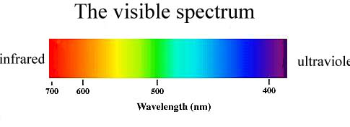
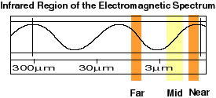
Introduction
What is spectrophotometry?
It does not have a particular range of wavelengths
Visible range vs. Infrared range
2
https://web.pa.msu.edu/courses/2000fall/phy232/lectures/emwaves/visible.html
https://www.univie.ac.at/geographie/fachdidaktik/FD/site/external_htmls/imagers.gsfc.nasa.gov/ems/infrared.html
Notes:
PARA QUE SE APLICAAAAA

Slide 3
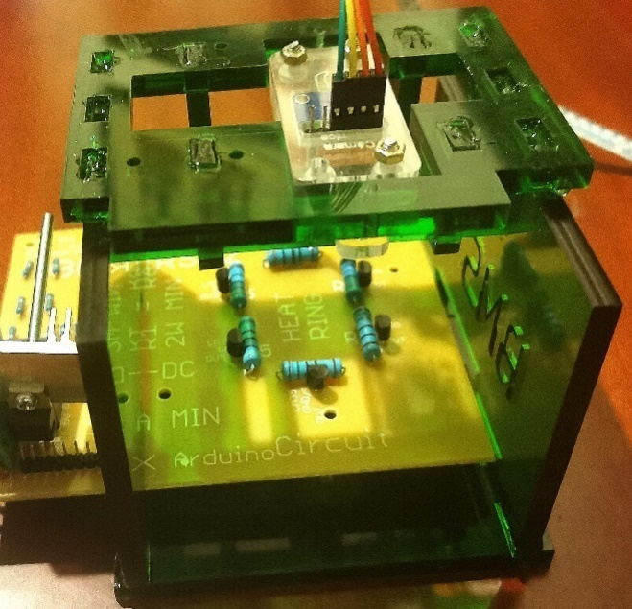
Content
Objectives
Scope
Methodology
System Analysis and Familiarization
Software Implementations
Calibration Methodology
Device Characterization
Conclusions
Recommendations
2
Notes:
The content of the presentation is as follows:
the objectives,
scope of the thesis,
the methodology employed WHICH includes the analysis and familiarization of the previous work. The software changes needed to create an electronic hub for the devices in the BioMicroSystems laboratory, as well as the calibration needed to properly use the thermal sensor to read the heat map of the standard microfluidic system. I’ll present results about the characterization of the device, as well the conclusions of the work done.
After which we’ll have some time for questions.

Slide 4
Objectives
General:
Calibrate and implement a device capable of taking temperature measurements through time using video-like characteristics and infrared cameras for microfluidic systems.
Specific:
Analyze and characterize the thermal camera for microfluidic systems considering thermal variations.
Design a data acquisition system that allows for proper data manipulation of the temperature measurements.
Implement a calibration system that allows the user to observe correct measurements in the proposed microfluidic systems.
3
Notes:
The general objective of the thesis is to
For this, it is necessary to analyze how the heat variations affect the thermal sensor
It is necessary to have software which allows for the proper manipulation of the data obtained
and most important, it is necessary to have a methodology which allows to correctly calibrate the device to observe the heat variations in the microfluidic system

Slide 5
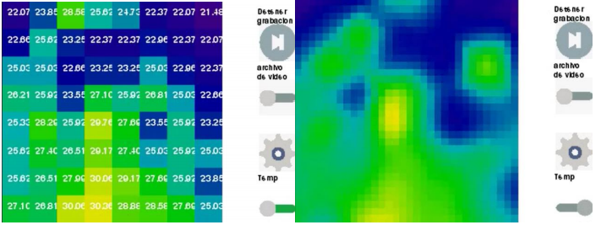
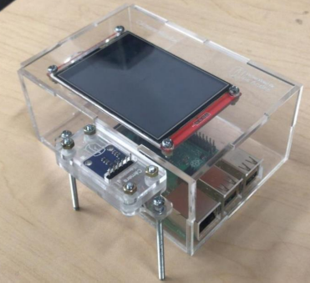
Previous Works
Seebeck Effect
Thermocouples
Thermal Baths
Previous Thermal Camera Implementation
3

Slide 6
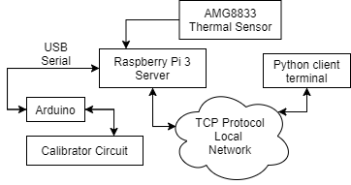
Scope
Raspberry Pi
Electronic hub
- Serial Communication
- TCP Communication
Capabilities
- Video Recording
Arduino
Calibration Circuit Prototype
- Data Capturing
- File Extensions
4
Notes:
The scope of the work consists of an electronic hub, which allows to communicate with microcontrollers as well as various devices.
The focus is to have serial communication with Arduino microcontrollers, to be able to control other laboratory equipment, like the thermal baths or the ultrasonic point.
It should also allow to capture data in various extensions to make it easier for the user.
On the right. Raspberry pi as electronic hub, which communicates with the Arduino microcontrollers through serial communication, as well as other computers through TCP.
For this implementation, the arduino controls a prototype of a calibrator circuit which should allow for the replication of the calibration process of the AMG8833 thermal sensor.

Slide 7
Methodology
Analysis of the software of the previous device
Analysis of modifications to create an electronic hub
Analysis of the performance of the previous device
Software implementations
Validation of the AMG8833’s calibration
Calibration of the AMG8833 thermal sensor
Creation of AMG8833 calibration methodology
Characterization of the device
5
Notes:
The methodology used is as follows.
First a familiarization of the device previously implemented, next the evaluation and implementation of the software changes.
Then the calibration methodology and finally, the characterization of the device using the standard microfluidic system

Slide 8



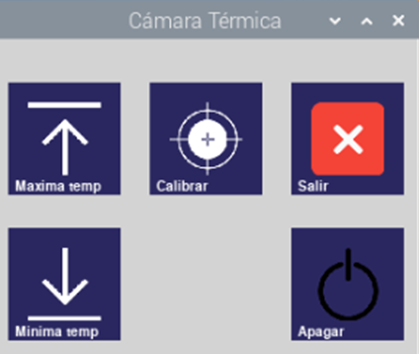


System Analysis and Familiarization
Embedded System
Data Capturing
Calibration
240X320 LED Touch Screen
USB drive per default
.CSV and .MKV
Not Simultaneous
Video Requires re-login
2 Point Calibration
PyGame
6
Notes:
Thermal camera, not properly designed for use as a hub with emphasis on thermal readings of microfluidic systems
The video recording can malfunction which logs out the user.
A lack of directory explorer, creates errors which freeze the program as the default is a USB memory. OFF button on the settings screen can compromise data

Slide 9

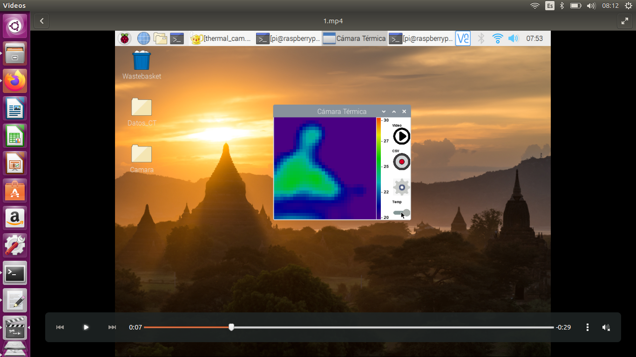
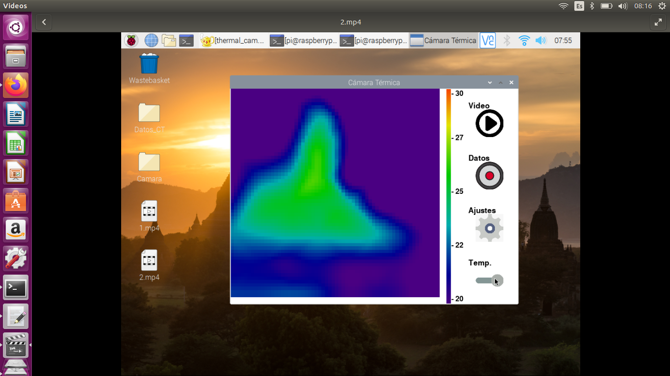
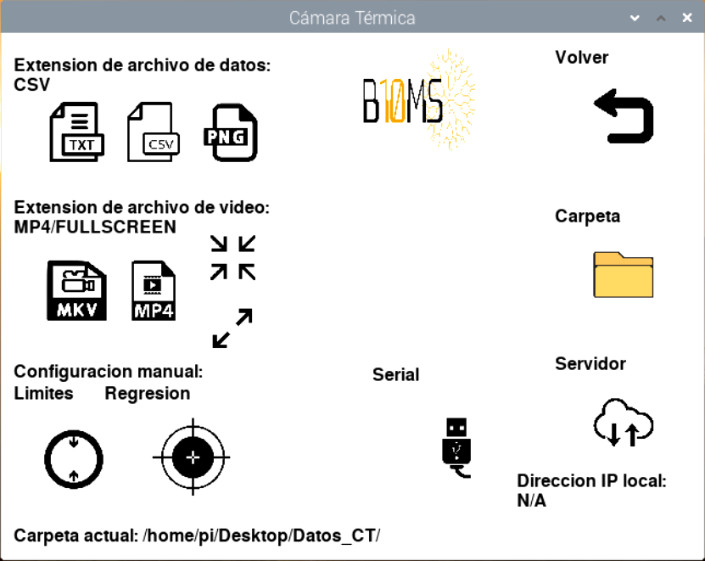
Software Implementations
Before After
Data Capturing
Interface
.CSV, .TXT, .PNG, .MP4, .MKV
Simultaneous Data and Video
Fullscreen or Heat Map
Doubled Interpolation Factor
Limited by Device
7
Notes:
The video capabilities were tied to the terminal, to make sure the program does not exit the user. Created more extension types as well as recording of fullscreen and heat map.
The size was modified as it no longer depends on the 240x320 LED screen. Allowed to double the size and the interpolation factor. The size was limited by the performance of the device.
The library used (PyGame) is not optimized for GUIs, the previous implementation had already implemented the refresh methods, and the threads, thus it would have been harder to start anew.

Slide 10


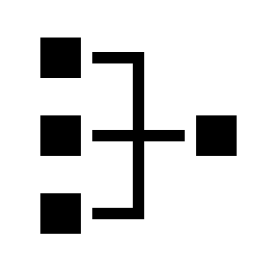
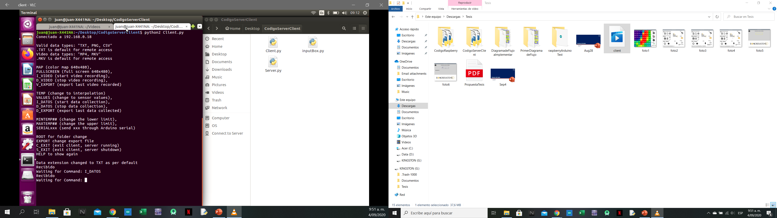
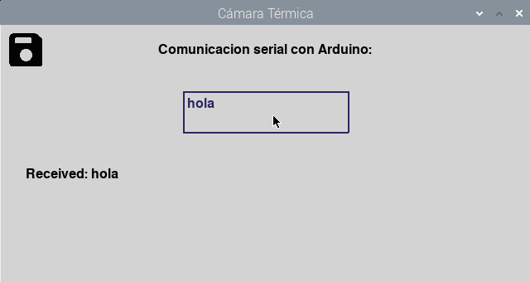
Software Implementations
TCP Communication
Serial Communication
Directory Explorer
CSM for Local IPs
Export Function
Remote Access
Arduino Input Box
Input Box tied to /dev
Root Folder
8
Notes:
TCP CSM communication through terminal. Allows for remote access, as well as an export function. Commands on the right.
Serial communication created through an input box tied to the microcontrollers /dev location. A new input box variable allows for direct communication to a new microcontroller.
Root folder directory eliminates errors associated with the USB drive not being present.
Overall, the device is able to behave like an electronic hub for the laboratory equipment.

Slide 11
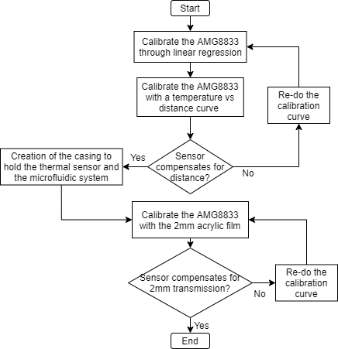
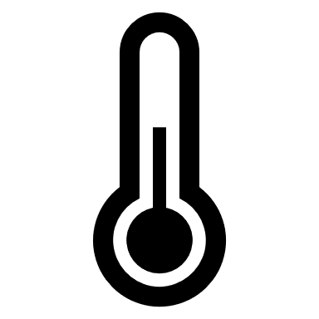
Calibration Methodology
The AMG8833 behaves like an infrared thermometer
Requires a distance vs temperature curve for heated surface measurements
9
Notes:
The AMG8833 behaves like an infrared thermometer, thus, a distance vs temperature curve is necessary for the proper manipulation of the device.
On the right, a flow diagram shows the methodology used for the calibration.

Slide 12
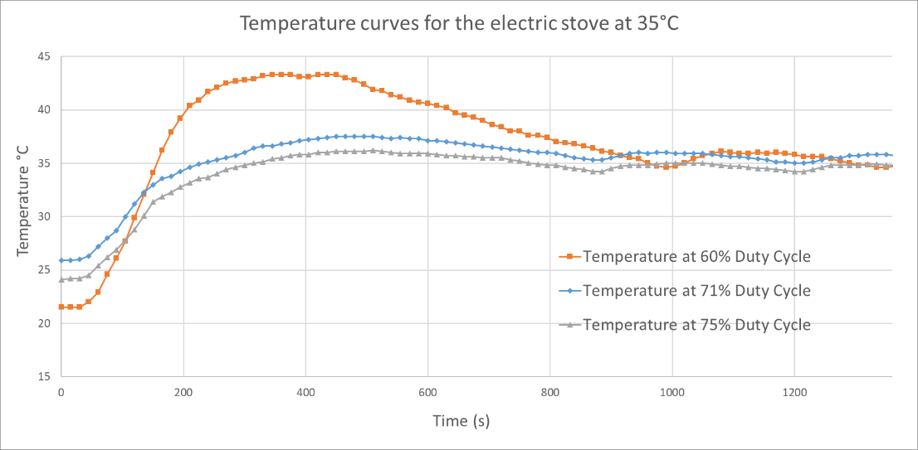
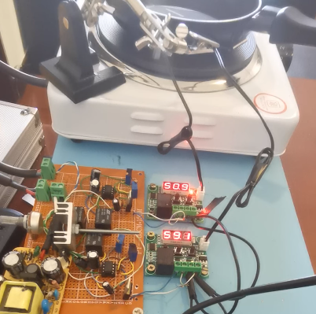
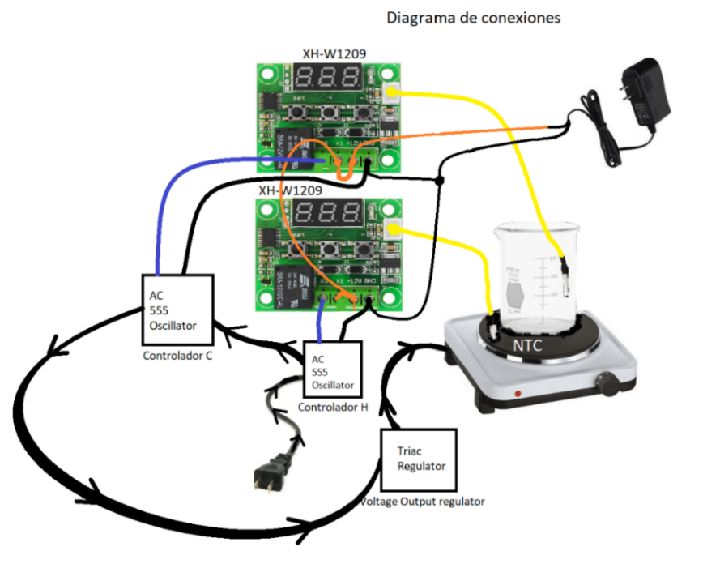
Calibration Methodology
Due to limited access to laboratory equipment, I created a heating plate using an ON/OFF controller with a feedback loop
10
Notes:
It should be noted, that due to Covid access to laboratory equipment was limited, and it was necessary to create a heating plate that could allow for proper thermal readings from the device.
The heating plate was implemented using an ON/OFF controller with a feedback loop that allowed for a 1,2°C uncertainty at 35°C. The range of temperatures which the heating plate was used for were from 30°C to 55°C.
The calibration of the heating plate implemented, does not possess the same temperature range as commercial heating plates (mostly because the AMG8833 only measures up to 80°C)
It is easy to replicate and has a low cost; approximately 100K COP

Slide 13
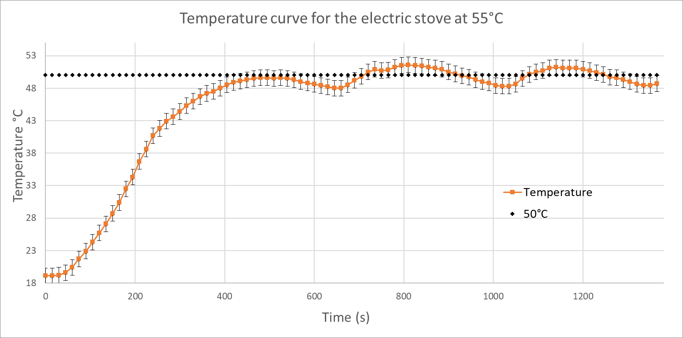
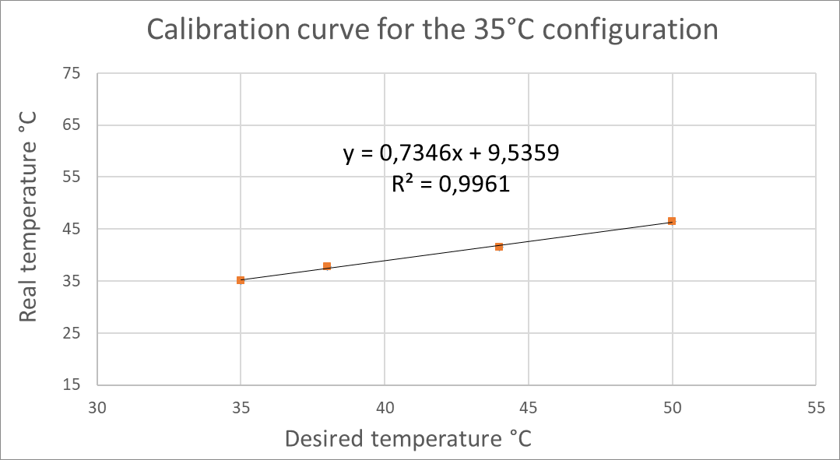
Calibration Methodology
The heating plate was calibrated using a submersible DT-11F thermometer and a BZ-R6 infrared thermometer
3
Notes:
TABLA DE COMPARACIÓN
REDUCCION DE COSTOS
REPLICABILIDAD

Slide 14
Calibration Methodology
The calibration of the heating plate implemented, does not possess the same temperature range as commercial heating plates (mostly because the AMG8833 only measures up to 80°C)
It is easy to replicate and has a low cost; approximately 100K COP
Temperature controlled heating plates can be found from 1M COP
The uncertainty values are on par with commercial ones
3
Notes:
TABLA DE COMPARACIÓN
REDUCCION DE COSTOS
REPLICABILIDAD

Slide 15
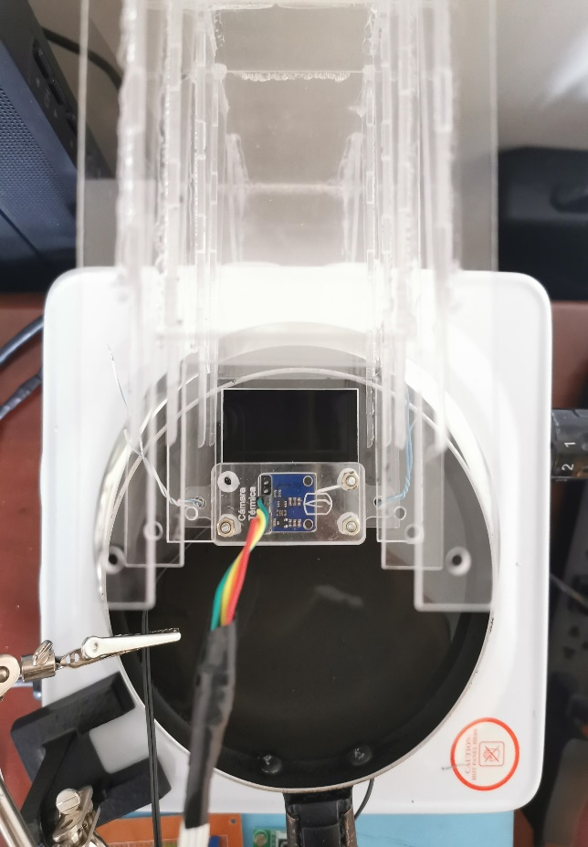
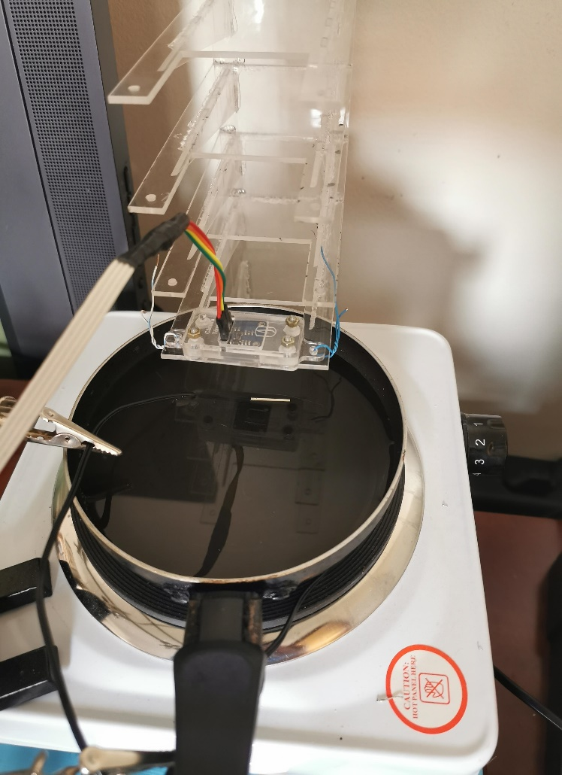
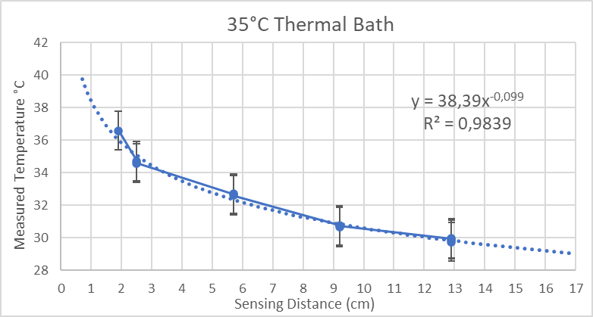
Calibration Methodology
The AMG8833 was first calibrated using the thermal bath as the heated surface
11
Notes:
The results were promising as it showed that the AMG8833’s reading does depend on distance. However, it would show an increase of about 10°C for 2mm,
More than the SUNPHOR BZ-R6
which the width of the acrylic used in the microfluidic system. Steam created variations which made this heated surface’s calibration inaccurate.

Slide 16
Calibration Methodology
The thermal variations created by the thermal bath made for an inaccurate calibration, the process was repeated with the heating plate as the heated surface
The calibration process extrapolates the correction needed for 2mm acrylic for 35°C, after which it is validated
12
Notes:
The process was repeated using the heated surface. After which, the increase in temperature was reliable. And a temperature correction could be extrapolated for 35°C at 2mm, using a linear regression.

Slide 17
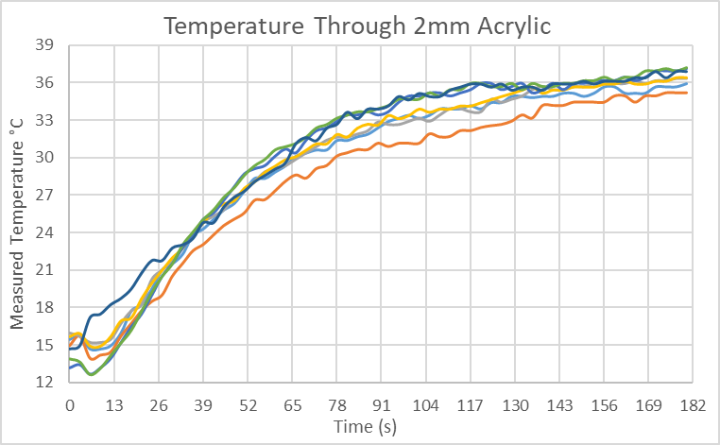
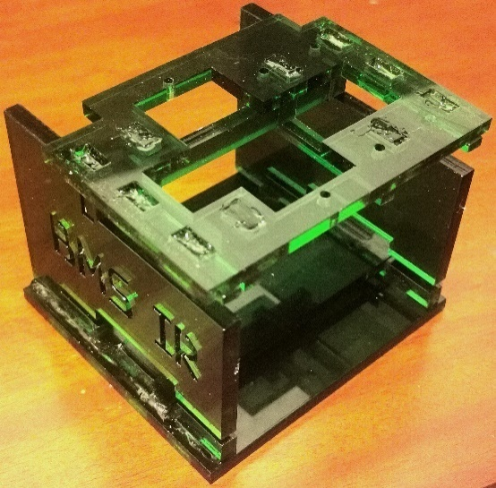
Calibration Methodology
The heating plate has a ±1.2°C uncertainty
Using the temperature correction, the values obtained for the 2mm acrylic film calibration proved correct
Final Casing
13
Notes:
The thermal sensor was placed on top of the 2mm acrylic, which was placed on the 35°C heated surface, it could be observed that the temperature correction proved correct. The heating plate’s uncertainty should also be accounted for.
It can be observed that although there are thermal variations, the system stabilizes at approximately 36°C.

Slide 18
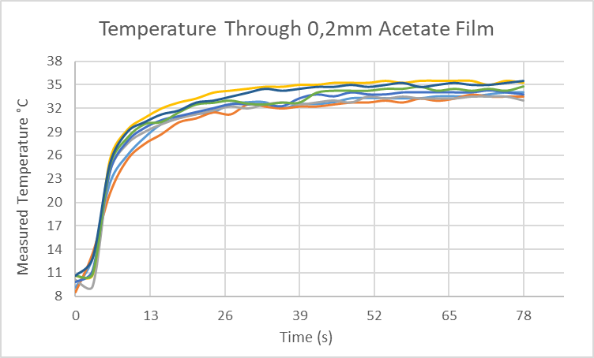
Calibration Methodology
The calibration also proved correct when the temperature correction was done for caliber 8 acetate
Caliber 8 acetate provides a faster response time
3

Slide 19
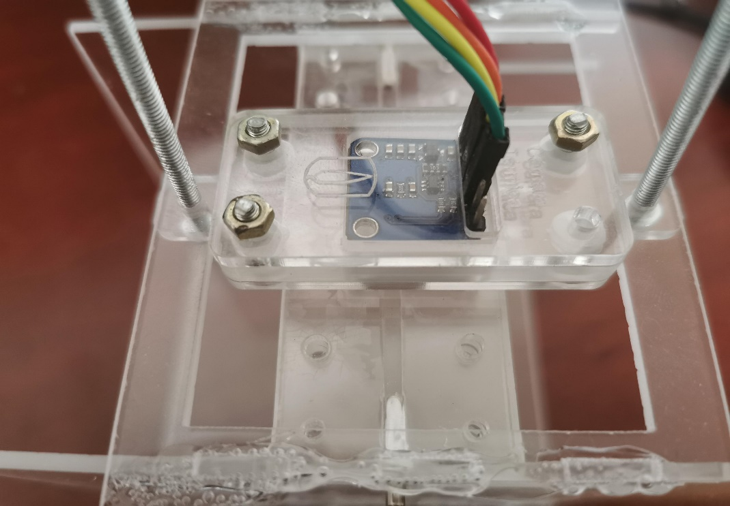
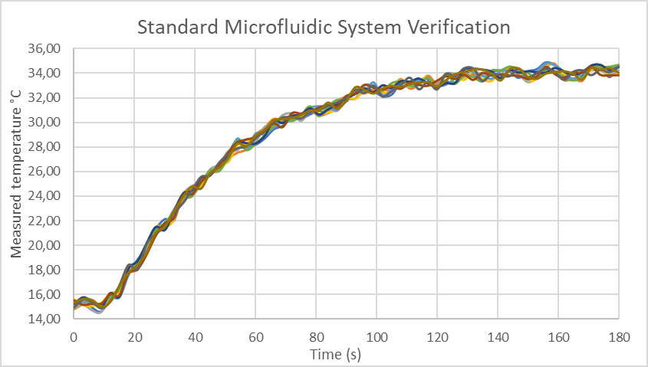
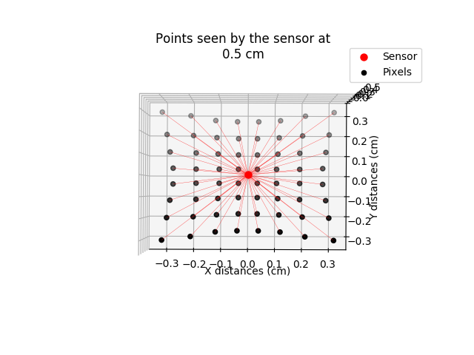
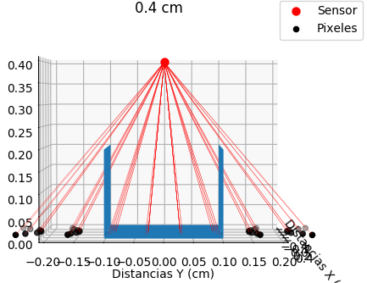
Device Characterization
Accounting for the heating plate uncertainty, it provides a 1°C difference from the 2mm acrylic calibration
The calibration file can be modified to take into account the difference
14
Notes:
For the characterization using the standard microfluidic system, it was necessary to create a model of the geometry of the lens. Using information from the datasheet, from which the distribution of the lasers can be observed at a specific distance, which allows to see how the lasers behave in the microfluidic system.
¼ of the lasers do not make direct contact with the system’s canal, which can create some unwanted variations, therefore, the creation of a microfluidic system using caliber 8 acetate should provide a better laser distribution and less temperature variations.
For the characterization process, thermal camera was placed on top of the system. It can be observed that taking into account the heating plate’s uncertainty, there is a 1°C difference from the 2mm acrylic calibration. If it is needed, this difference can be modified in the calibration file in the device’s system files.

Slide 20
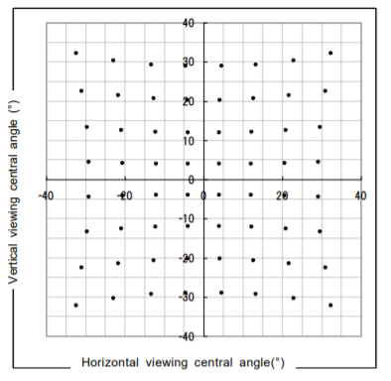
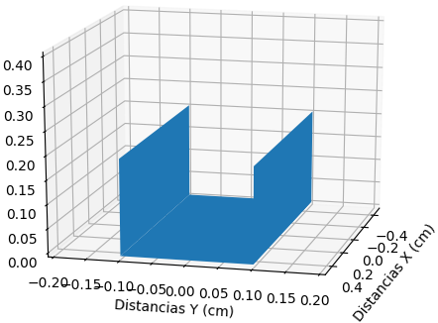
Device Characterization
Small part of the microfluidic system was modeled
Models from lens geometry found on the AMG8833 datasheet, to find laser distances
3

Slide 21
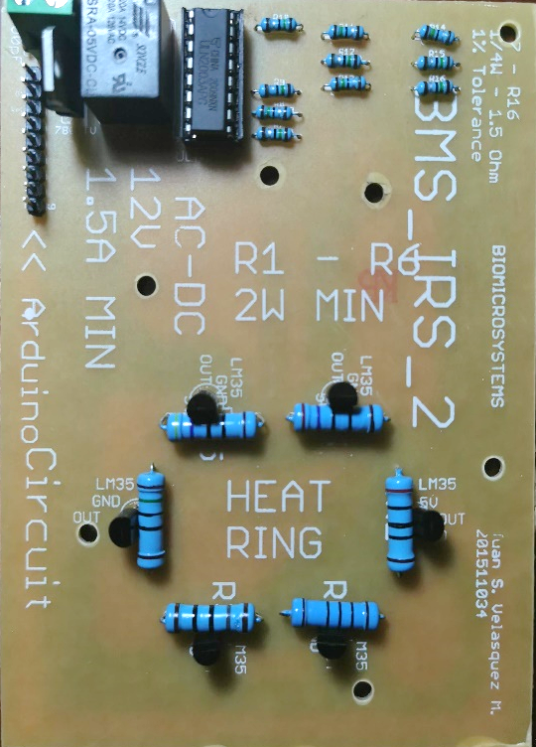
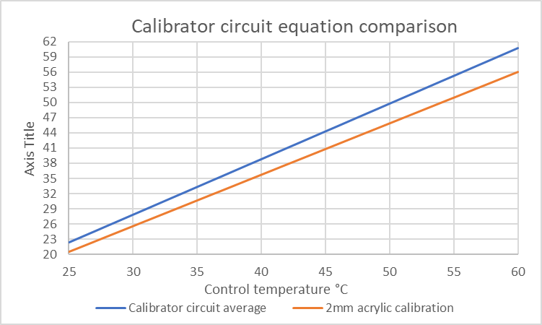
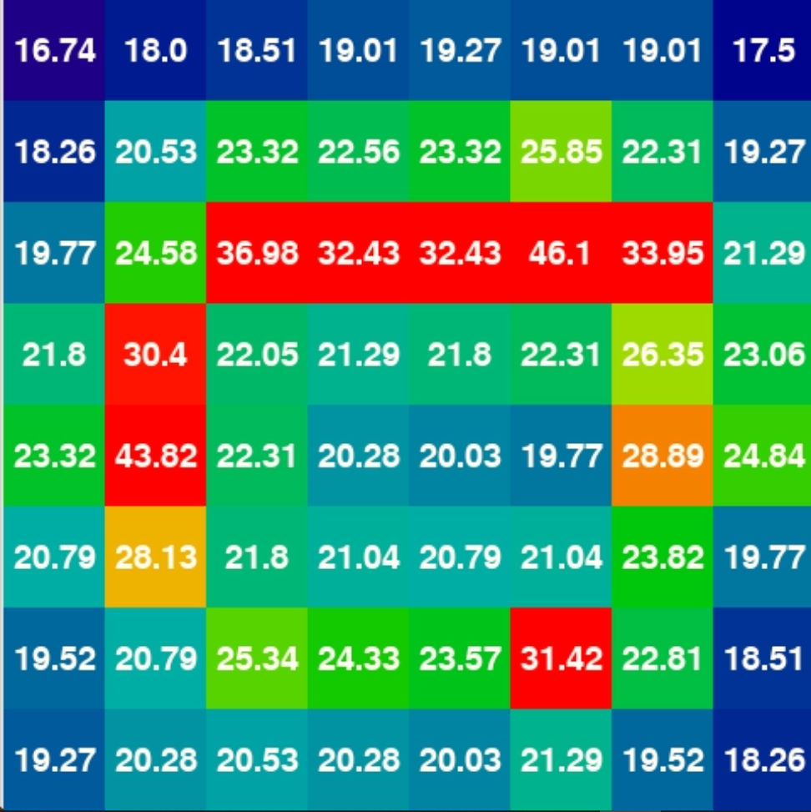
Device Characterization
Prototype to recreate the calibration process
Initially accounts for the 74mm temperature correction to correlate the LM35 sensors’ data with the thermal map
Measured temperature °C
15
Notes:
A calibrator circuit prototype was created to recreate the calibration process.
The circuit creates a gradient temperature ring, at a known distance from the sensor, which allows to correlate temperature readings from the sensor to the circuit’s LM35s.
This implementation takes into account a temperature correction for 74mm, using the calibration process implemented, although it is not as precise as the 2mm acrylic calibration, it has the same behavior.
It can be observed that for the 35°C, there is an error of 2.5°C, which increases to 4°C at 50°C, which is an average error of 8% with respect to the control temperature.

Slide 22

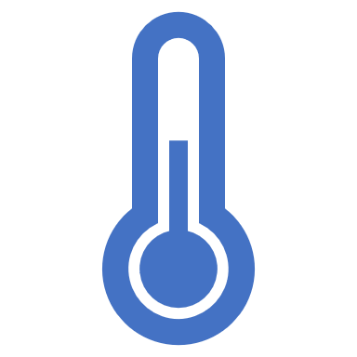


Conclusions
The program implemented captures data and video in different extensions simultaneously, keeping the user’s session.
The calibration methodology proved correct in accounting for thermal variations, although a more thorough process could have decreased the 1°C difference.
The program behaves as an electronic hub by having serial and TCP communication, which also provides a file export function over local IPs.
The characterization using the standard microfluidic system is reliable and the calibration process can be easily replicated.
16

Slide 23
Recommendations
Microfluidic System Material
Caliber 8 acetate provides approximately a 75% faster thermal response time.
Width of 0.2mm
Software GUI Library
The PyGame library is not optimized for GUIs
16
Notes:
ACETATO CALIBRE 8
LIBRERIA DEL SOFTWARE
PLACA CALEFACTORA

Slide 24
Thank You
Questions?

